Slide 1
pH and Indicators

Slide 2
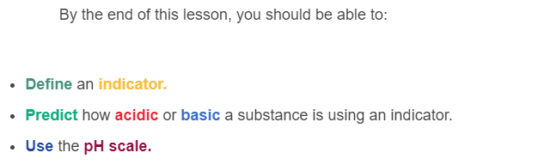
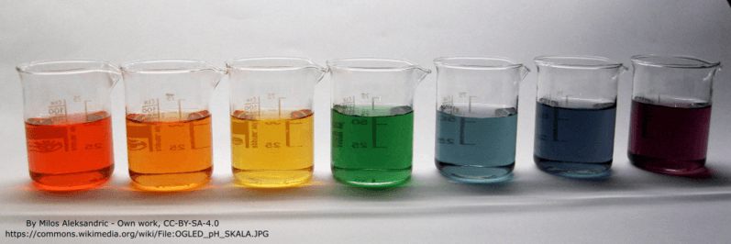

Slide 3
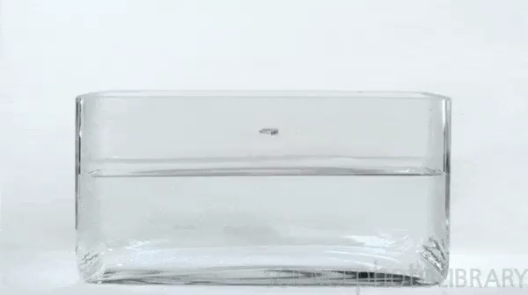
An indicator is a chemical that changes colour depending on how acidic or basic a solution is.
Indicators provide immediate feedback, meaning that they change colour as soon as the acidity or basicity changes.

Slide 4

Acids and bases can be thought of as opposites, with acids at one end of a line, or spectrum, and bases at the other.
In the very middle are substances that have no acidity or basicity - we call these substances neutral.
Water is a good example of a neutral substance - it is not acidic or basic.

Slide 5
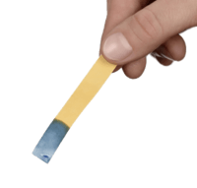
The simplest indicator is litmus paper.
Litmus is a chemical-soaked piece of paper that, when dipped in solution, will turn red for acids and blue for bases.
The most common type of litmus paper is yellow. In this case, if the solution is neutral, the paper will stay yellow.

Slide 6
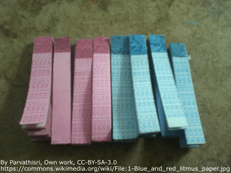
Chemists also use one-colour litmus paper.
Blue litmus paper turns red in acids, and red litmus paper turns blue in bases.
Both of these types of paper will not change colour in neutral solutions.

Slide 7
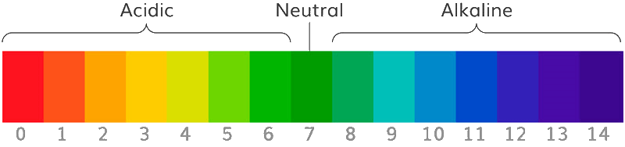
The level of acidity or basicity of any solution is measured on a scale called pH.
The pH of a solution is a number between 0 and 14.
The higher the number, the more basic, or alkaline, the solution will be.
The lower the number, the more acidic the solution will be.

Slide 8
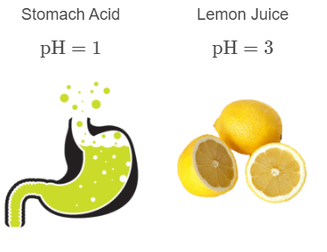
If the pH of a solution is less than 7, the solution is acidic.
The lower the pH, the more acidic the solution.
For example, a solution with a pH of 1 is more acidic than a solution with a pH of 3. This means that it will be more reactive and dangerous.

Slide 9
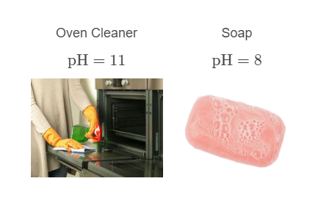
If the pH of a solution is more than 7, the solution is basic.
The higher the pH, the more basic the solution.
For example, a solution with a pH of 11 is more basic than a solution with a pH of 8. This means that it will be more reactive and dangerous.

Slide 10

If the pH is 7, the substance is neutral.
The most common neutral substance is pure water.
Neutral solutions are neither acidic nor basic - they sit right in the middle of the pH scale.

Slide 11
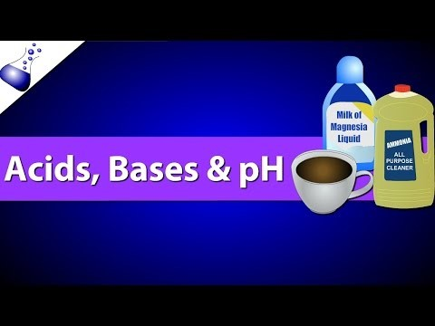

Slide 12
A common indicator is universal indicator.
This mixture of many different indicators provides a rainbow of colours that flow from bright red for the strongest acids, green for neutral and purple for the strongest bases.
Each colour can be matched to a number on a way of measuring acidity called the pH scale. Bright red is pH 1, green is pH 7, and purple is pH 14.

Slide 13
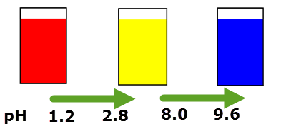
Most other indicators change colour at a particular pH, but it does not have to be pH 7.
For example, the indicator thymol blue uses three different colours. It is red below pH 1.2−2.8, blue above pH 8.0−9.6, and yellow in between.
Most indicators have transition periods where neither colour dominates. Between 1.2 and 2.8, thymol blue will be an orange colour (mixing yellow and red).

Slide 14
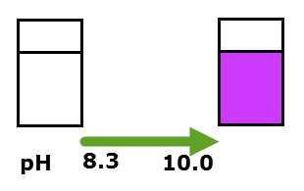
Phenolphthalein is an indicator with two different colours.
It is colourless below pH 8.3 and pink above pH 10.
It is used mainly to indicate when a substance changes from being an acid to a base.

Slide 15
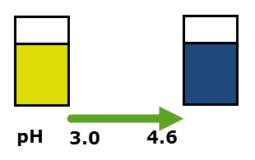
Bromophenol blue is an indicator with two different colours.
It is yellow below pH 3.0 and blue above pH 4.6.
It is used to monitor acidity, and as a dye.

Slide 16
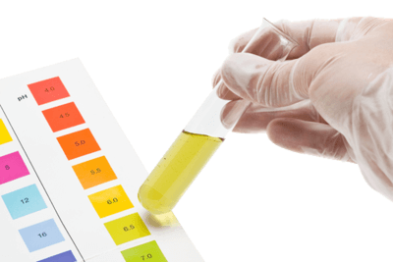
There are many more indicators than those listed above. Some have two transitions, and some have just one.

